Slide 1
Deploying Django and React Web application with Apache & mod_wsgi

Slide 2
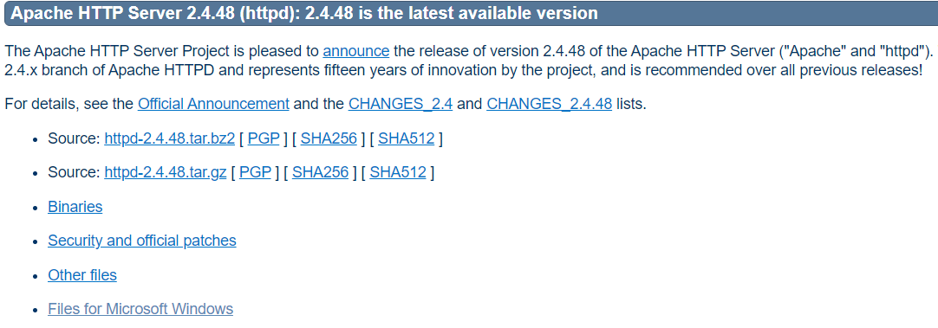
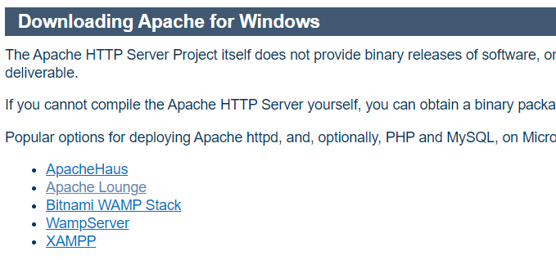
Installation of Apache Server
- First step is to download the apache server
- Download the apache server from official documentation using following link - https://httpd.apache.org/download.cgi
- Based on computer configuration you have to download(For windows, macos, linux systems)
- For windows have to download Apache Lounge

Slide 3
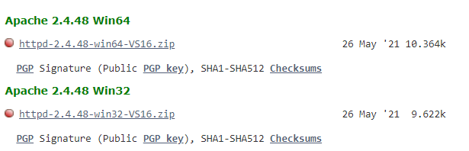
Cont...
- After Clicking on Apache Lounge below page will open
- Based on windows bit version (32bit or 64bit) download respective zip file
- Extract zip file and keep anywhere in your system for further use.

Slide 4
Apache with mod_wsgi
- WSGI is the main python standard for communicating between Web servers and applications, but it only supports synchronous code.
- The mod_wsgi package implements a simple to use Apache module which can host any Python web application which supports the Python WSGI specification.
- First Create virtual environment and navigate to backend project folder.
- Install mod_wsgi using below command
pip install mod_wsgi
- Then after successful installation of mod_wsgi run below command
mod_wsgi-express module-config
- Then copy the output and paste it in apache httpd.conf configuration file for loading mod_wsgi.

Slide 5

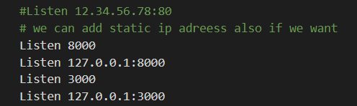

Basic Configuration
- First open the httpd.conf file make some basic configurations.
- Define the serverroot that is where apache server is installed.
- Next define the ports of your application for react and django
- Open backend project folder and activate virtual environment, edit wsgi file with below code - path of activated environment.

Slide 6
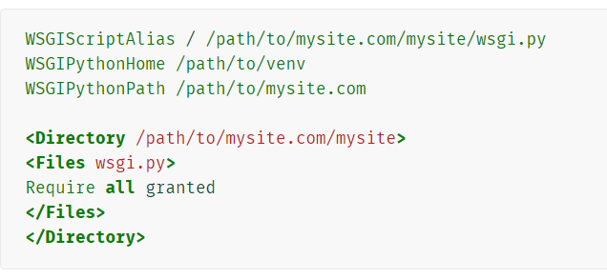
Configuration of django backend part
- Next you need to make configuration for backend part.
- Once you’ve got mod_wsgi installed and activated, edit your Apache server’s httpd.conf file and add the following.
- The WSGIScriptAlias line is the base URL path you want to serve your application at root url, and we have to add path of wsgi file on your system.
- The WSGIPythonHome is the path of our environment in your system.
- The WSGIPythonPath is the path of backend project folder in your system.
- The <Directory> path ensures that Apache can access your wsgi.py file,
which is required all granted.
- If you are using jwt authontication, pass below line inside <virtualhost*8000>
WSGIPassAuthorization On

Slide 7
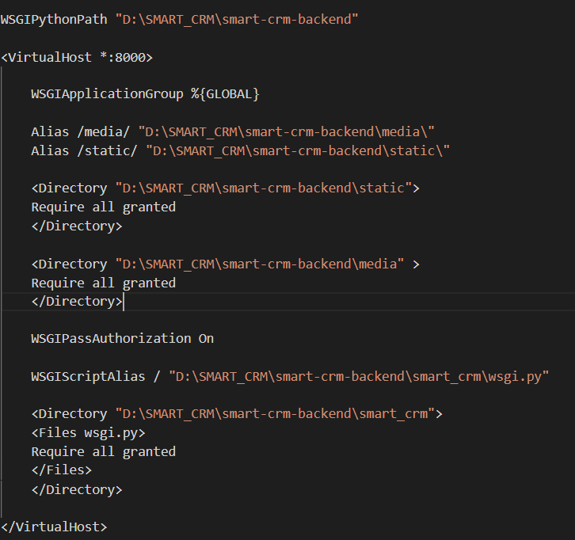
Configuration of static and media files
- Django doesn’t serve files itself, it leaves that job to whichever Web server you choose.
- To serve media files on Apache you can use Django as a VirtualHost, you can set up Apache to serve some URLs as static & media, using the mod_wsgi interface to Django.
- Then Copy the path of static and media files from your project directory and add to httpd.conf configuration file.
- Also run this in backend project folder
python manage.py collectstatic.

Slide 8
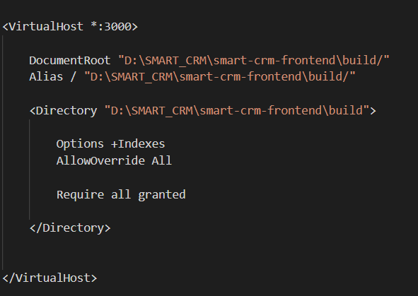
Configuration of React frontend part
- First navigate to react project folder and run below command
npm run build
- In project folder build file will create, copy the path of build file and paste it in httpd.conf configuration file as like below -
- Build file sufficient for hosting react application on apache server
- This file contain all static,media and js and css code with index.html.

Slide 9
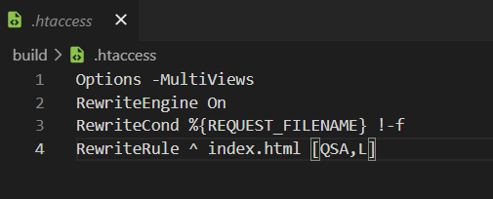
Cont...
- Create .htaccess file in public folder and add below code
- React will server the application from base url and it will be present in build file that is index.html
- From there the application will be executed.

Slide 10
Running Commands
- Then open cmd with run as adminstrator
- Navigate to apache bin directory folder .
- We are using this as a service as application so we need to install first,
- Then run the below command
httpd.exe -k install
- Run below command to start the service
httpd.exe -k start
- Server will start now and open in chrome with mentioned ports.
- if you want to restart the server run below command
httpd.exe -k restart
Some useful commands will get using this command - httpd.exe -h

Slide 11
Environment Creation using virtualenv
- For creating environment using virtualenv first download specific version of python.
- Then navigate to respective project folder
- Install virtualenv using below command,
pip install virtialenv
- Then run the below command to create env file with respect to project
virtualenv env
- Then activate environment using below command
.\env\Scripts\activate
- For deactivate just use deactivate command.

Slide 12
Thank You

